Slide 1
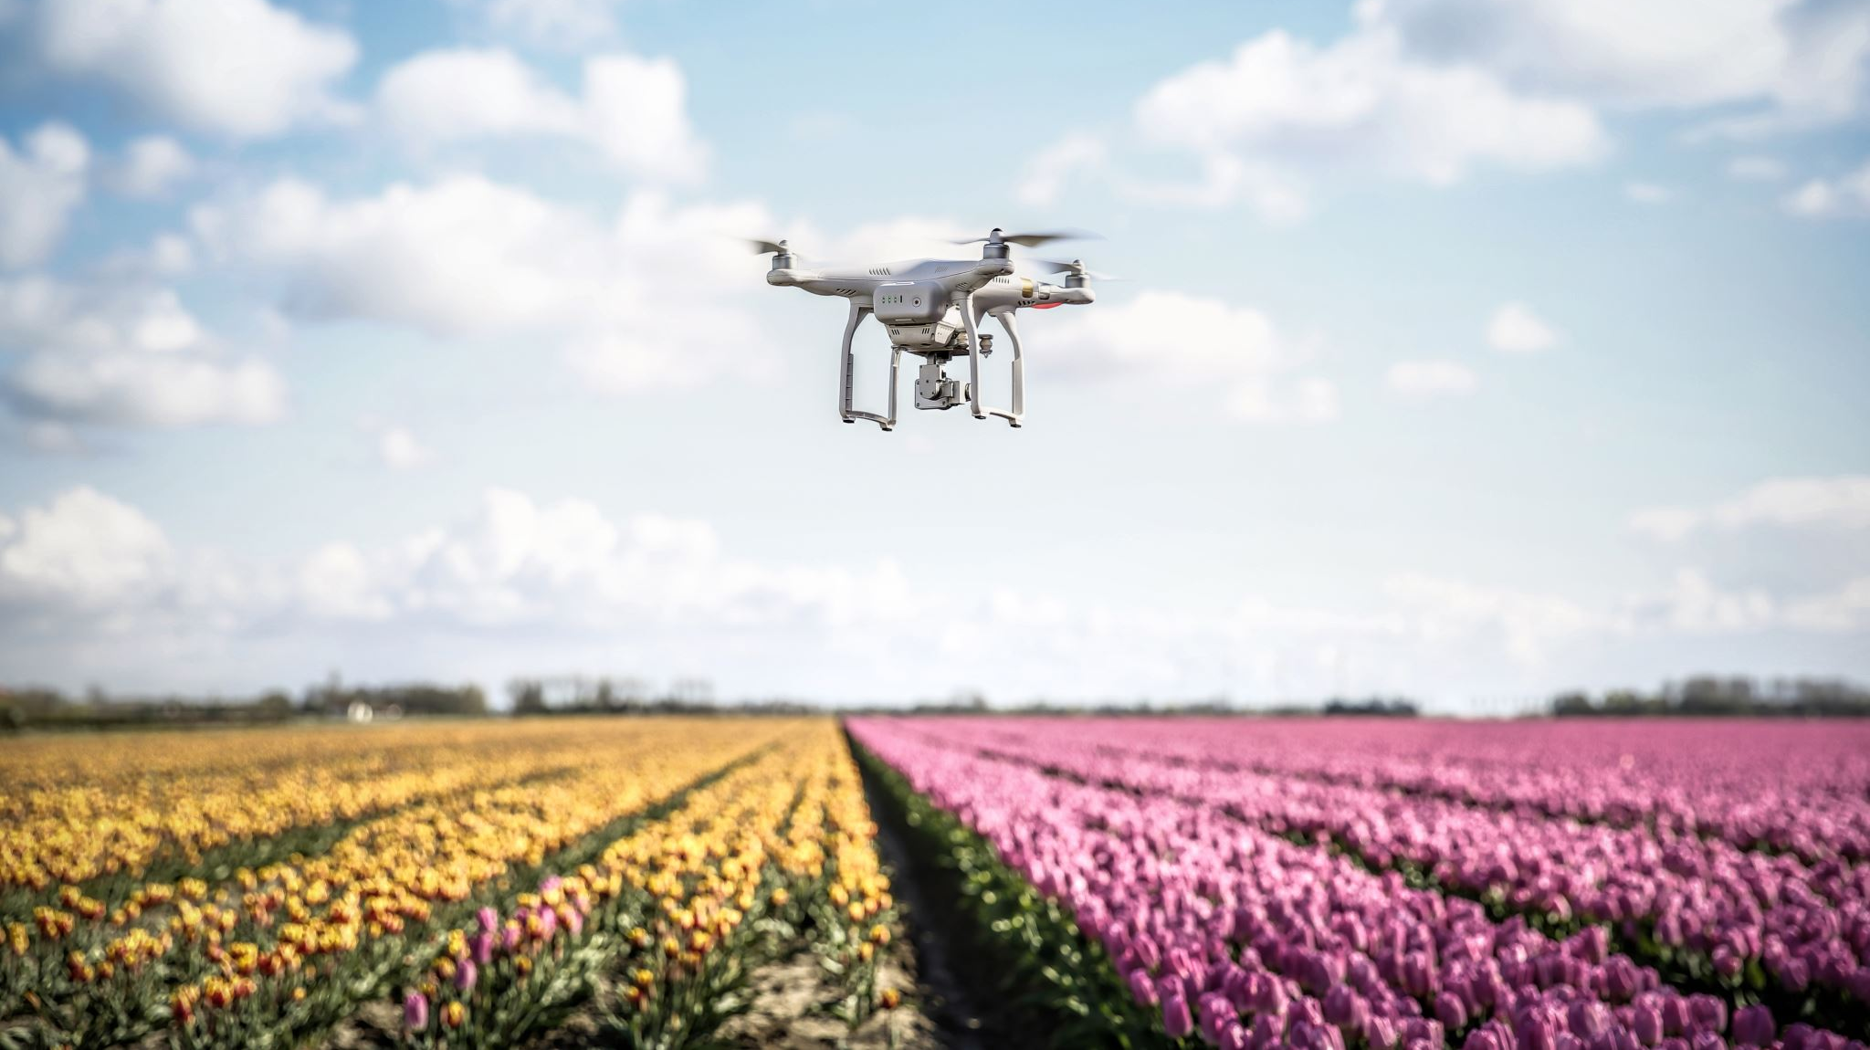
Surveillance Drone Cloud – Location Tracking
Design Document

Slide 2
BASIC Communication HANDSHAKE (Location Tracking)
UI
Drone
Server
Database
Configure tracking
settings
Sends the location information in real-time
Location data stored in Database for that droneID
Pings back the configured tracking information

Slide 3
List of Parameters (Drone -> Server)
Out of all the parameters below, user can configure what data to track.
Parameter | isDefault | Description
Latitude | Yes | Get latitude of the current location.
Longitude | Yes | Get longitude of the current location.
Altitude | Yes | Get altitude of the drone
Time stamp | No | Retrieve time stamp of each set
Tracking interval | No | How often to track (in sec)
Speed | No | Current speed of the drone

Slide 4
API DESIGN
REQUEST
RESPONSE
API-1
Get Real-Time Location API
GET
Current Location Response
Location Tracking
API-2
Save Location To Database API
POST
Confirm Saved Response
Get Location To Database API
GET
Location Results Response
API-3

Slide 5
API DESIGN – Get Realtime location
API Name | API Parameters | Description
Request Get Location | Type: GET URL: <server_ip>/get-location/<drone_id> Body: drone_id – Drone ID drone_maker – Drone Manufacturer drone_model – Drone Model name | Get most recent location of the drone. The tracking interval determines how often we get the real-time location.
Response Get Location | Status – 200 Ok or 400 Bad Request Response JSON: latitude: float – Drone Latitude longitude: float – Drone Longitude altitude: float – Drone Altitude timestamp: dateTime – Drone Timestamp

Slide 6
API DESIGN – SAVE location
API Name | API Parameters | Description
Request Save Location | Type: POST URL: <server_ip>/save-location/ Body: drone_id – Drone ID drone_maker – Drone Manufacturer drone_model – Drone Model name msg: JSON – Object containing latitude, longtitude, altitude, and timestamp. | Save Location to MongoDB cloud database.
Response Save Location | Status – 200 Ok or 400 Bad Request Response JSON: message: string – “Location Saved Successfully”

Slide 7
API DESIGN – Get List of locations - REQUEST
API Name | API Parameters | Description
Request Get Location from Database | Type: GET URL: <server_ip>/get-tracking/<drone_id> Body: drone_id – Drone ID drone_maker – Drone Manufacturer drone_model – Drone Model name | Get a drone’s all previously tracked locations from MongoDB.

Slide 8
API DESIGN – Get List of locations - REsponse
API Name | API Parameters | Description
Response Get Location from Database | Status – 200 Ok or 400 Bad Request Response JSON: { tracking_data: JSON array [ { id: string - ID of location log object in database, drone_id: int - drone ID, longitude: float - longitude the drone was at, latitude: float - latitude the drone was at, altitude: float - altitude the drone was at, timestamp: string - time when at this location, } ] }

Slide 9
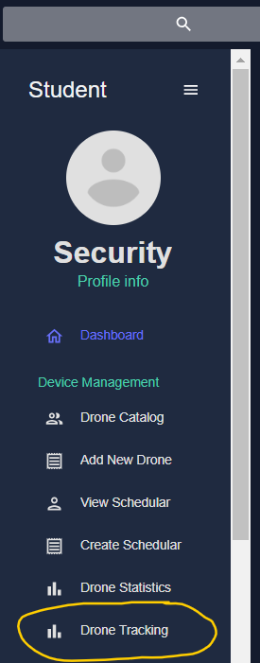
GUI ACTION FLOW
First, user navigates to tracking page from his dashboard.

Slide 10
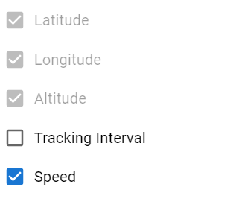
GUI ACTION FLOW
A pop-up to configure the parameters.
Latitude, Longitude, and Altitude are by-default enabled.

Slide 11
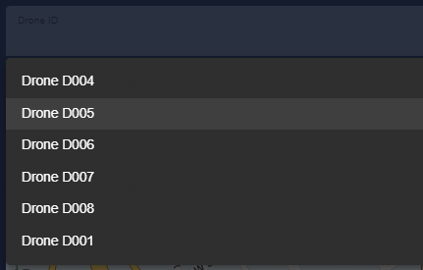
GUI ACTION FLOW
Out of all the drones, user chooses a drone from the list of drones assigned to him.
This triggers an API call to get the real-time location data.

Slide 12
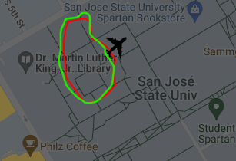
GUI ACTION FLOW
API responds with the real-time location data and injects it into the Map Utility.
The Map utility then plots the path on the map in green color. Note that the map already will have mission-planned path in red color.
User therefore now can compare the actual vs planned path.
Actual Path
Mission Planned Path

Slide 13
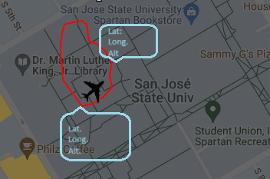
GUI ACTION FLOW
User can hover over the path to get the latitude, longitude, altitude information.

Slide 14

Thank you

